Slide 1
Viral Hepatitis
(病毒性肝炎)
Guozhong Gong(龚国忠） MD.
Department of Infectious Diseases
The Second Xiangya Hospital CSU
Institute of Hepatology CSU

Slide 2
Liver functions
Metablism(protein, glucose, energy, drug……)
Immunity
Hemaopoitic(especially in fetus )

Slide 3
What’s viral hepatitis
Liver injury caused by hepatitis viruses
Clinically manifestions: from asymptomatic to life threatening
Lab findings: ALT, AST, Tbil, PT,
Albumin

Slide 4
Etiology
HAV
HBV
HCV
HDV
HEV

Slide 5
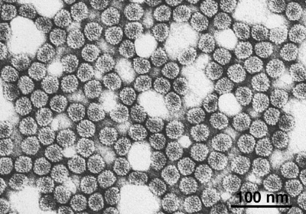
HAV
Found by Feintone in 1973 in a focal specimen. HAV is a naked icosahedral symmetry(二十面对称） particle with a diameter of 27 nm

Slide 6
HAV
Single-stranded small RNA virus, belongs to hepatovirus.
Has been successfully cultivated in cell cultures, which facilitates its biological studies, and vaccine production.
Only one serotype.
Good stability, alive more than 1 month under nature, resistant to 60℃for 1 hour.
Inactivated by boiling, chlorination, ultraviolet.

Slide 7
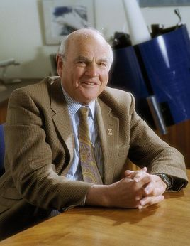
HBV
Baruch Samuel Blumberg, MD. Ph D, 1925-2011, Nobel prize owner (1976)for discovery of Australia antigen (HBsAg)

Slide 8
HBV
Enveloped double-stranded DNA virus
Belongs to hepadnaviridae（嗜肝病毒属）, other animal related viruses have been identified : WHV(土拨鼠肝炎病毒) , GSHV(地松鼠肝炎病毒）, DHBV（鸭乙肝病毒）
Includes 3200 nucleotides comprieing 4 open reading frames(ORF) : S C P X regions.
Replicates very efficiently, 4 ORFs overlapes

Slide 9
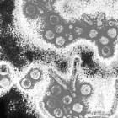
HBV : Down particle, Tubular, long tubular

Slide 10
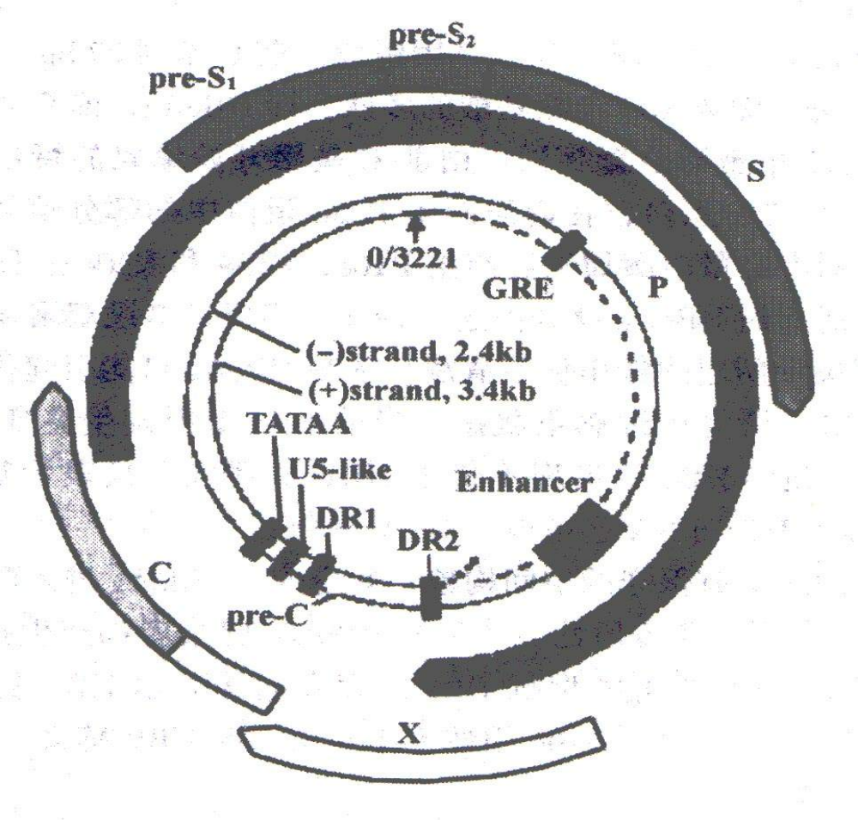
HBV
The model map of HBV genes

Slide 11
HBV Gene products
Surface Antigen(HBsAg): Three initiation codons within the surface gene, so three related proteins are produced:
LHBsAg: translated from pre-s1 initiation codon.
MHBsAg: from pre-s2 initiation codon.
SHBsAg or major HBsAg: from S initiation
codon., which is the main surface protein and
accounts for 80% to 85% of total surface protein.

Slide 12
HBsAg：
Important serologic marker
Appears earliest
Strong antigenicity
Serum subtypes: adr, adw, ayr, ayw.
Anti-HBs :
Neutralizing antibodies to HBsAg appears
in the convalescent period

Slide 13
Core gene: two initiation codons within the core gene, so two proteins are produced
HBcAg: forms the nucleocapsid core of the virus. there is no free HBcAg in serum
Two types of antibodies to HBcAg
Anti-HBc-IgG Appears later, existing for a long time
Anti-HBc-IgM Appears sooner, indicating a new infection or relapse.

Slide 14
HBeAg: Translated also from pre-core initiation code
HBeAg: HBV replication.
Pre-C mutation: HBeAg is not produced, but HBV is still active in replication and the disease is still in progression.

Slide 15
Polymerase
Encoded by P gene which entirely overlaps with S gene, and partially overlaps with Core gene and X gene.
A very important enzyme which is special for HBV and functions as reverse transcriptase(RNA DNA)and DNA polymerase (DNA DNA)

Slide 16
X protein
Encoded by X gene
Closely related to HCC(原发性肝细胞癌） because of its trans-activity
Essential for replication because viral genomes with mutations in the X gene fail to produce active infection in culture.

Slide 17
HCV
Discovered in 1989 by molecular cloning
Single-stranded positive-sense RNA virus
that belongs to the the flaviviridae family.
The genome of HCV is approximately
9600nt and contains a single ORF capable
of encoding a large viral polypeptide
precursor of 3010 amino acids.

Slide 18
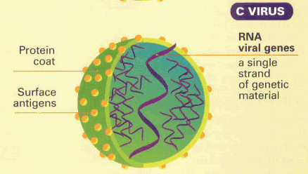
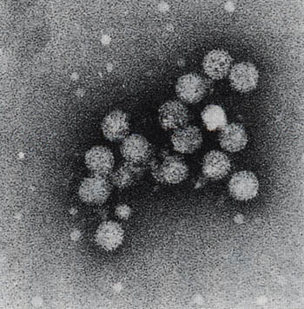
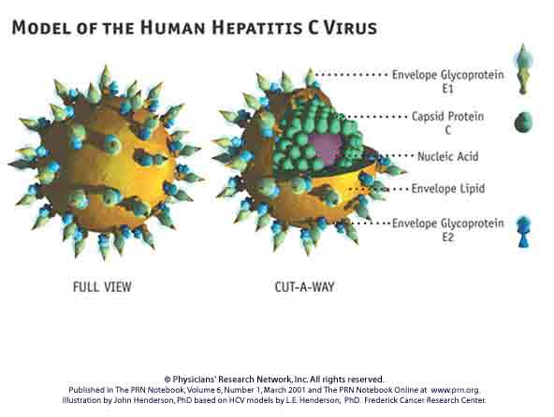
HCV particles by electronic microscope and schematic diagram

Slide 19
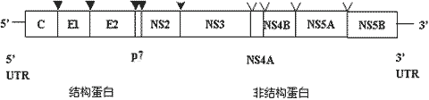
HCV Gene Structure

Slide 20
Like many other RNA viruses, HCV has a very high mutational rate that results in considerable genomic heterogeneity.
At least six major genotypes identified. Genotypes(1-6) differs in geographic distributions (in China, mainly genotype 1) and associates with disease progress or response to therapy.

Slide 21
HDV
The HDV was discovered by Mario Rizzetto in 1977.
HDV is a defective virus.
HDV requires the presence of HBV to provide its protein envelop to infect.
HDV is found only in persons with HBV infection and plays an important role in liver failure.

Slide 22
HEV
Single positive-strand RNA .
four genotypes were found. G1 and G2 are only infective to human. G3 and G4 are infective both to human and animal.
In China, G1 is epidemic and G4 is sporadic
Despite of the genotypes, there appears only one serotype

Slide 23
Epidemilology
Reservoir of infection
Human being (patient or carrier) is the Source of infection of all above mentioned hepatitis viruses.
Pig as one of sources of infection is still unclear in HEV.

Slide 24
Routes of transmission: fecal/oral route (HAV,HEV)
Person-to-person is the most important means of transmission.
Transmission via contaminated food or water is well described and may be associated with outbreaks of HAV and HEV

Slide 25
Routes of transmission
Blood and body liquids (HBV,HCV,HDV)
The modes of transmission include:
Blood and blood products,
Inadequately sterilized or shared
Syringe
Sex
Intravenous drug use
Tattooing, and so on

Slide 26
Susceptible population
Person who has not been infected or not vaccinated are susceptible to hepatitis viruses
In our country HAV , HEVand HBV vaccines are available , HBV vaccine is also useful in prevention of HDV infection
HCV vaccine are still under investigation.

Slide 27
Pathogenesis
Mechanisms of hepatocyte injury are poorly understood.
In general, viral infection induces liver injury in two ways: direct cytopathic or indirect immune-mediated injury.

Slide 28
Clinical manifestations
General symptoms: fatigue, malaise
Digestive tract symptoms: loss of appetite, nausea, vomiting, abdominal discomfort, and right upper abdominal pain.
Main signs : jaundice, enlargement of liver and spleen

Slide 29
Acute hepatitis
Icteric and anicteric
Digestive tract symptom: nausea, vomiting, diarrhea and abdominal pain
High ALT and AST level

Slide 30
Chronic viral hepatitis
Virus: HBV, HCV, HDV
time: ＞6 months
Severity: mild
moderate
severe

Slide 31
Chronic viral hepatitis
Repeated attack of anorexia, jaundice,
abdominal distention
Hepatomegaly, splenomegaly
Extra-hepatic manifestations: hepatic face, capillary dilation in the face, vascular spider, liver palms.

Slide 32
Hepatitis gravis
Severe digestive tract symptoms
Progressively elevated jaundice
Obvious hemorrhagic tendency or
bleeding
Rapid development of ascites
Rapid development of hepato-renal
syndrome
Hepatic encephalopathy

Slide 33
Hepatitis gravis
Acute liver failure (fulminant hepatitis)
within 14 days
Subacute liver failure (subacute fulminant)
15 days to 6 months
Acute on chronic liver failure: Acute or subacute liver failure on chronic liver diseases
Chronic liver failure: progressive liver failure on
chronic hepatic disease

Slide 34
Cholestatic hepatitis
Prolonged cholestasis, The duration of
jaundice exceeds 3 weeks(usually 2 to 4
months)
Pruritus, clay-colored stool
Mild digestive tract symptoms and mild
abnormal liver function
Apparently elevated AKP, r-GT

Slide 35
Cirrhosis
Active cirrhosis:
with symptoms and elevated ALT
Silent cirrhosis: Stable
Compensatory cirrhosis
no ascites, encephalopathy, hemorrhage
Decompensated cirrhosis: jaundice,
ascites, blooding, hepatic encephalopathy,
hepatic- renal syndrome

Slide 36
laboratory Findings
Biochemistry markers
Markers for liver injury: ALT, AST, very
sensitive, but not parallel to the severity
Markers for liver function: albumin,
bilirubin, prothrombin time or PTA
Markers for differential diagnosis:
DBIL/TBIL, AKP, GGT

Slide 37
Liver biopsy
Degeneration: Ballooning , acidophilic.
Necrosis: Spotty, Focal, Piece-meal (PN), Bridging (BN), Confluent.
Inflamation: lymphocytes infiltration
Fibrosis:

Slide 38
Lab findings for chronic hepatitis staging
mild moderate severe
ALT or AST ≤ 3 ULN ≥3 ULN ≥3ULN
TBIL ≤ 2 ULN ＞2-5ULN ＞5ULN
ALB ≥ 35 32-35 ≤32
A/G ≥ 1.4 1.0- 1.4 ≤ 1.0
PTA(%) ＞ 70 60-70 40-60
CHE ＞ 5400 4500-5400 ≤4500

Slide 39
Etiologic examination
HAV: Anti-HAV-IgM, early,
Anti-HAV-IgG, later
HBV: serologic markers: HBsAg Anti-
HBs; HBeAg Anti-HBe; Anti-HBc-
IgM Anti-HBc-IgG.
HBV DNA
HCV: HCVcAg, Anti-HCV
HCV RNA

Slide 40
HDV: HDAg, Anti-HD
HEV: Anti-HEV

Slide 41
Diagnosis and differential diagnosis
Based on the followings:
Epidemiological data:
Clinical features: anorexia, nausea
hepatomegaly
Laboratory findings: elevated ALT
eteologic findings

Slide 42
Basic requirements for format of diagnosis
Intact diagnosis of viral hepatitis includes clinical diagnosis and etiological diagnosis.
Writing format examples:
1. Acute icteric hepatitis
Anti-HAV-IgM(+)

Slide 43
2. Chronic viral hepatitis
HBsAg(+)
3. Acute anicteric hepatitis
Eteology unknown

Slide 44
Differential diagnosis
Hemolytic jaundice
Obstructive jaundice
Toxin-induced and drug-induced jaundice
Other infectious hepatitis: EBV, CMV
typhoid fever, sepsis , leptospirosis
Hereditory Gilbert syndrome,
dubin-johnsin symdrome, WD et al.

Slide 45
Treatment
General treatment:
Good rest
Sufficient nutrition
Proper drugs for protecting liver
Avoiding drugs which injury liver
Antiviral Therapy

Slide 46
Acute hepatitis
Bed rest
Supportive treatment: give adequate nutrition, maintain the fluid, electrolyte and acid-base balance of the body
Liver-protective drugs :

Slide 47
Antiviral treatment
Chronic hepatitis B
Indications: HBVDNA(+), ALT>2UNL,
Histological changing >G2/S2
Drugs: Interferon alpha ; Nucleotides
IFN-a or PegIFN-a
First approved antiviral agent
Two main actions: Inhibition of viral
protein synthesis and immuno-regulatory
effects

Slide 48
Two kinds of IFNs available:
IFN-a 3-5 million U, subcutaneous use , 3 times/week for 6 -12months
(2)Peg-IFNs:
A Peg-IFNa-2a (Pegasys): 180ug
subcutaneous use, qw
B Peg-IFNa-2b (Pegintron): 1-
1.5ug/kg, subcutaneous use, qw

Slide 49
Side effects of IFN
Fever, chill, myalgia, fatigue, arthralgia
Myelosupression: WBC, PLT
Deterioration of liver function
Alopecia
Depression
Hyperthyroidism or hypothyroidism

Slide 50
Nucleotides
Inhibition of HBV DNA polymerase
L-nucleotids: Lamivudin(贺普丁), Telbivudine(替比夫定) , Clevudine(克拉夫定)
Nucleoside analogs,
HBV DNA decreasing rapidly
very safe
rebound when treatment stopped
long time treatment
Drug resistance occures freguently

Slide 51
Nucleotides
Inhibition of HBV DNA polymerase
Adefovir(ADV，阿得福韦),
Tenofovir(TDF，替诺福韦)，TAF(磷丙替诺福韦）
No cross drug resistance with L- nucleotides
Drug sesistance occures rarely
Inhibition effect of Adefovir is not strong
Tenofovir and TAF is strong
Renal and BMD dysfunction（ADV，TDF）
TAF more safer in Renal and BMD

Slide 52
Nucleotides
Inhibition of HBV DNA polymerase
Entecavir(恩替卡韦)
Inhibition of HBV rapidly and strongly
Drug resistance occures rarely
Drug-induce carcinogenesis is under
investigation

Slide 53
Benefit from Antiviral Agents
Decrease disease progress
Decrease development of hepatocellular carcinoma
Delay or stop development of liver de-compensation
Gain good life quality

Slide 54
Anti-viral therapy for HCV infection
Progression in anti-HCV infection
Treatment with IFN alfa
SVR <20%
Addition of RBV to IFN alfa improved outcomes
SVR ~40%
Peg-IFN alfa plus RBV becomes gold standard
SVR >55%
Peg-IFN alfa plus RBV + proteinase inhibitor
SVR>70%
Peg-IFN alfa plus RBV+ NS5A or NS5B inhibitor
SVR>90%
IFN free DAAs conbination
SVR>95%

Slide 55
PegIFN+Ribavirin
Peginterferon a and ribavirin(利巴韦林), generally 48weeks
Suitable for serum HCVRNA positive
Regimen according to genotype
Effect for Genotype 2,3 is better than 1,4

Slide 56
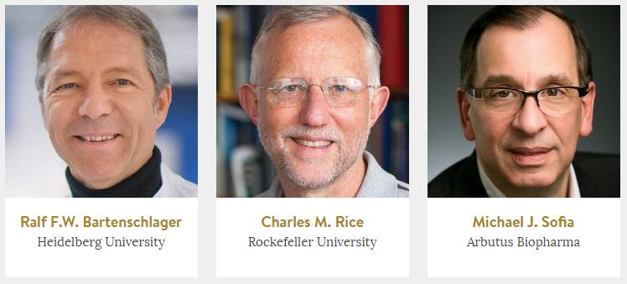
Direct Anti-viral angents(DAAs)
2016年拉斯克（Lasker）奖获得者

Slide 57
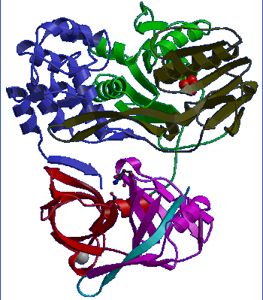
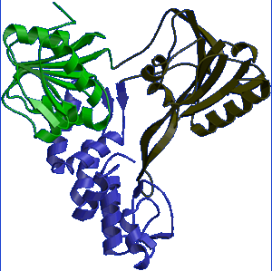
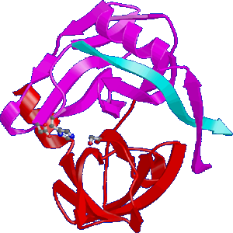
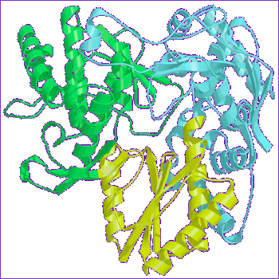
DAAs for HCV Infection
Targets of Hepatitis C Antiviral Agents
capsid
envelope
protease/helicase
polymerase
C
E1
E2
p7
NS2
NS3
NS4A
NS4B
NS5A
NS5B
NS3/NS4 Protease
domain
NS5A
NS5B RNA-dependent
RNA polymerase

Slide 58
DAAs作用靶点及代表药物
NS5A抑制剂：Daclastasvir，Ombitasvir，Samatasvir，Velpatasvir， Elbasvir, Ledipasvir, etc 。
蛋白酶抑制剂（NS3/NS4)：Teleprevir, Boceprevir, Simeprevir, Paritaprevir, Asunaprevir,Grazoprevir, etc.
NS5B抑制剂：Sofosbuvir，Dasabuvir，Beclabuvir，etc.

Slide 59
DAAs available in China
Pan-genotypic：SOF/VEL，SOF/RB，SOF/DAC
Genotpye 1： SOF/VEL，SOF/RB，SOF/LED, SOF/DAC , 3D，择必达，单诺瑞韦+PR,
4-5级肾功能（基因1）：3D，择必达
4-5级肾功能（非基因1）： SOF/VEL，SOF/DAC
肝功能损害明显或失代偿： SOF/VEL，SOF/RB，SOF/DAC

Slide 60
Treatment for gravis hepatitis
Vigorous supportive treatment.
Treatment is centered on intensive support
of the failing organ to provide the optimal
environment for liver regeneration.
Bed rest, use of fresh-frozen plasma,
maintaining of fluid and electrolye
balance, acid base balance

Slide 61
Treatment for gravis hepatitis
Antiviral therapy
Suitable for those caused by HBV
Drugs: nucleotides

Slide 62
Symptomatic treatment
Encephalopathy: a low protein diet, use of oral neomycin or lactulose, administration of branched chain amino acid, early detection and treatment of cerebral edema.
Bleeding: correction of prothrombin time with fresh frozen plasma, supplemant of vit K, use of H2 receptor blockage

Slide 63
Renal failure: including function renal failure and acute tubular necrosis. Use of albumin or plasma, low-dose dopamine infusion, renal replacement therapy.
Secondary infection:
Causes: impaired cell-mediated and humoral immunity, neutrophil adherence and phagocytosis and Kupper cell function are compromised. Bacteria translocated from the gut into systemic circulation.

Slide 64
人工肝支持系统（ALSS）
借助体外机械、理化或生物反应装置
血浆置换
血浆吸附
血液滤过
分子循环吸附
  清除：有害物质
  补充：蛋白质和凝血因子
  维持：内环境稳定
肝细胞再生肝功能恢复
暂时替代
肝脏功能
人工肝支持系统（ALSS）：简称人工肝，是暂时替代肝脏部分功能的体外支持系统，其治疗机制是基于肝细胞的强大再生能力，通过体外的机械、物理和生物装置，清除各种有害物质，补充必需物质，改善内环境，为肝细胞再生及肝功能恢复创造条件，或作为肝移植前的桥接。

Slide 65
ALSS的分型
分型 | 主要技术与装置 | 功能和临床应用
I型（非生物型，NBAL） | 血浆置换（PE）、血浆灌流（PP）、胆红素吸附（BA）、血液滤过（HF）、血液透析（HD）、分子循环再吸附MARS、普罗米修斯系统等 | 以清除毒性物质为主，其中PE还可补充生物活性物质；临床应用广泛
II型（生物型，BAL） | 以体外培养的外源性肝细胞为基础构建体外生物反应装置；主要有Li-BAL系统、ELAD系统、BLSS、RFB系统等 | 具有肝脏特异性解毒、生物合成及转化功能；临床试验阶段
III型（混合型，HAL） | I型与II型结合应用；主要有Li-HAL系统、HepatAssist系统、MELS、AMC系统等 | 兼具有I型和II型功能；临床试验阶段

Slide 66
非生物人工肝支持系统(ALSS)技术
血液灌流(hemoperfusion-HP)：血液吸附，能清除中分子量有毒物质
血液透析(hemodialysis-HD): 通过弥散作用清除溶质，平衡水电解质，去除代谢产物
血液滤过(hemofiltration-HF): 通过对流作用清除溶质，清除中、小物质有毒产物
血浆置换(plasmaexchange-PE)：清除病毒和毒物，补充蛋白质、凝血因子，调节AA比例
血浆置换滤过（plasma exchange hemofiltration）：PERT
血浆透析滤过(plasmadiafiltration-PDF):PE+HD+PF = PDF
血浆吸附滤过(PP): 血浆吸附(PA)+血浆滤过(PF)==PP
配对血浆置换吸附滤过：（CPEFA)coupled plasma exchange filtration adsorption
分子吸附再循环系统（molecular adsorbent mcirculating system, MARS）
连续白蛋白净化系统（continuous albumin purification system, CAPS）
双重血浆分子吸附系统（double plasma molecule adsorb system, DPMAS）

Slide 67
liver transplantation
The most promising new therapy for fulminant liver failure is emergency liver transplantation.
The 1-to-2 year survival rates have range between 60% and 90%.

Slide 68
Prevention
Hepatitis A
(1) Active immunization: live attenuated
vaccines, formalin-killed vaccines
(2) Passive immunization: immune
serum globulin :given within 2 weeks
after exposure
(3) Improving food and water sanitation

Slide 69
Hepatitis B
(1) Hepatitis B vaccines: recombinant
vaccines
(2) Hepatitis B immune globulin (HBIG)
(3) Combination of active and passive
immunization
(4) Using disposable of needles

Slide 70
Hepatitis C
(1) Screening blood donor
(2) Using disposable needles

Slide 71
HDV:
Same as HBV
HEV
Vaccination

Slide 72

Thank you!

